Slide 1

Kill Arnie Rhode
Pitch Deck (Sample)
By Isaac Edejer

Slide 2
Log Line
Arnie Rhode has been turned into a cyborg following an alleged “mishap” by Syndicated Corporations (a.k.a. SyndiCorp), a globally dominant tech company.
Arnie escapes the clutches of SyndiCorp and attempts to say goodbye to his loved ones before going into hiding.

Slide 3
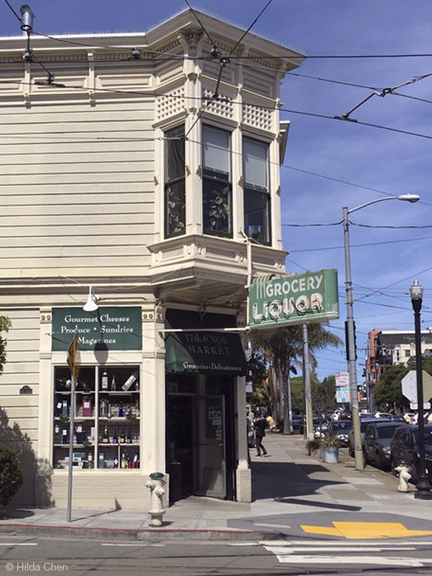
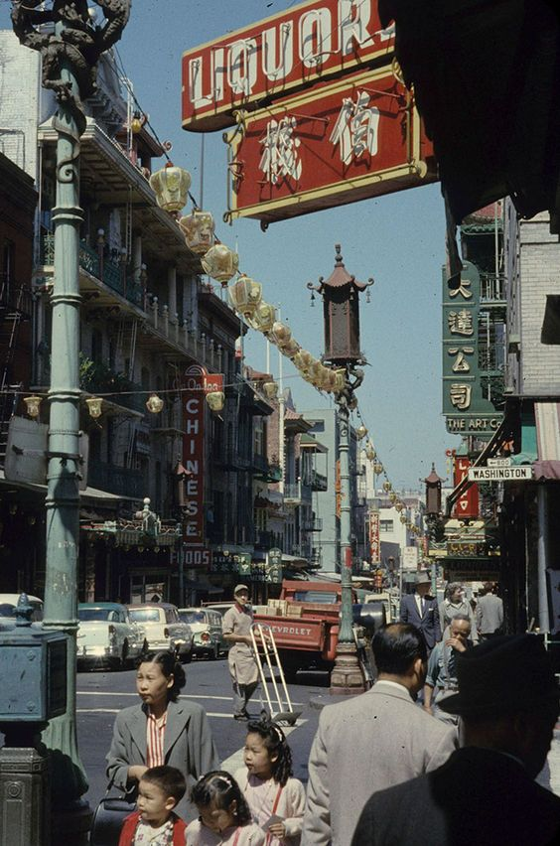

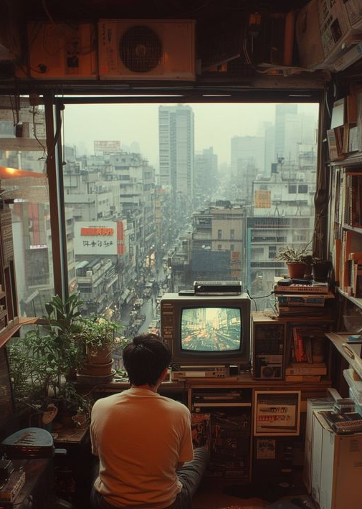
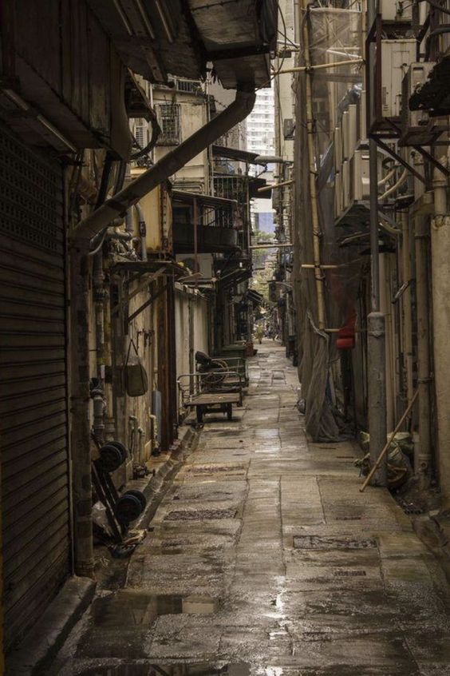
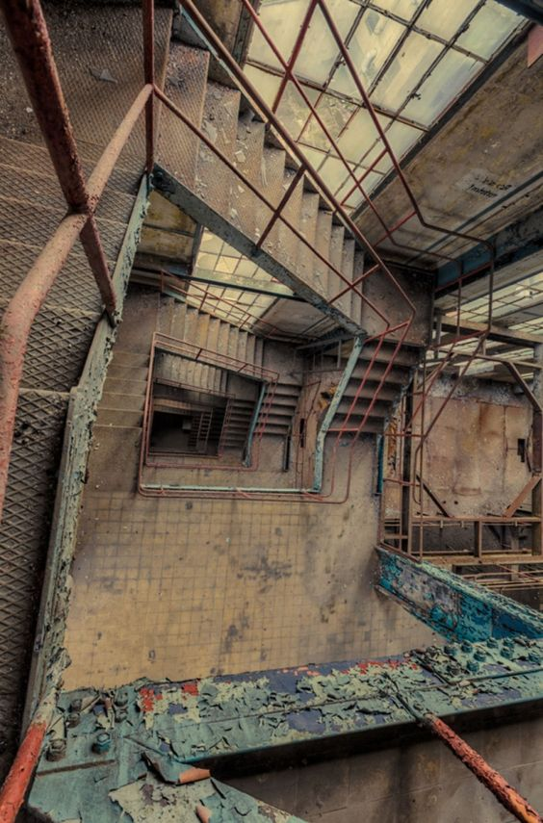
The City of UltraVille
“Clock Out and Get to Work”
Based off my hometown: Richmond, California. Ok, not really my hometown, per se, but it’s the heart of my childhood. All the towns along the north shore of the East Bay Area are former company towns whose economies were dependent upon Chevron refineries; our community has long been adversely affected by the very means of our existence.

Slide 4
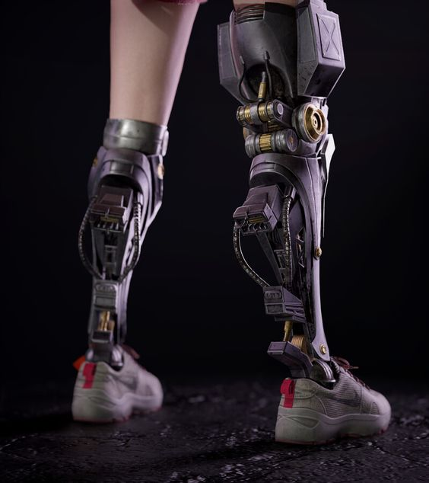
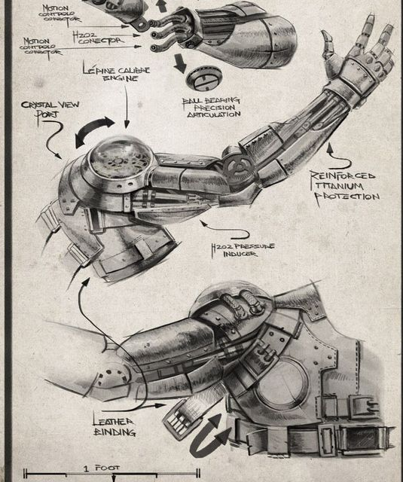
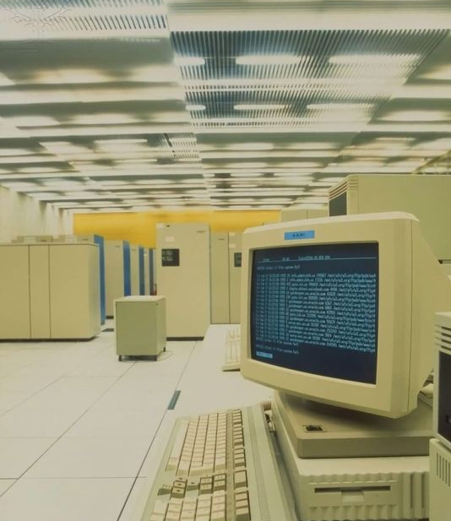
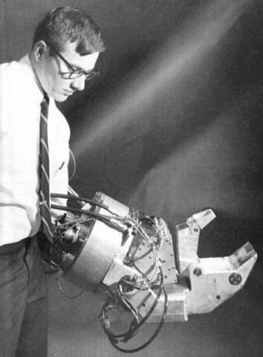
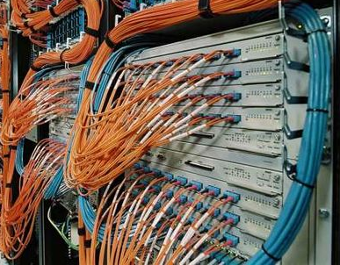

SyndiCorp – Products
“From the ignition in your car, to the pacemaker in your heart. While other companies plan for obsolescence, SyndiCorp believes in technology that lasts a lifetime.
“Syndicated Corporations. Making Life Better Since 1917.”

Slide 5
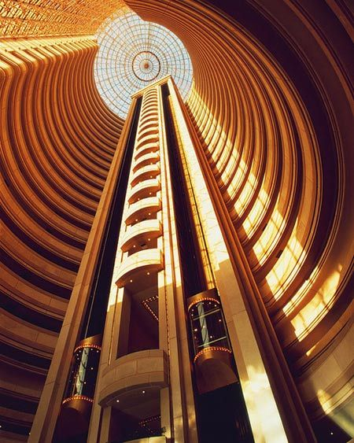
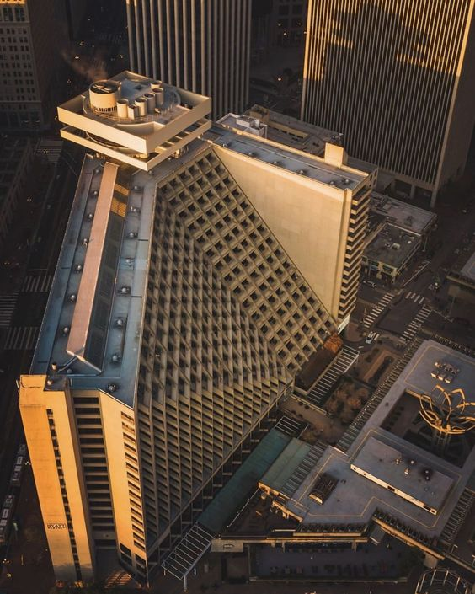
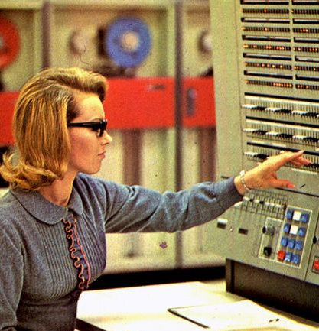
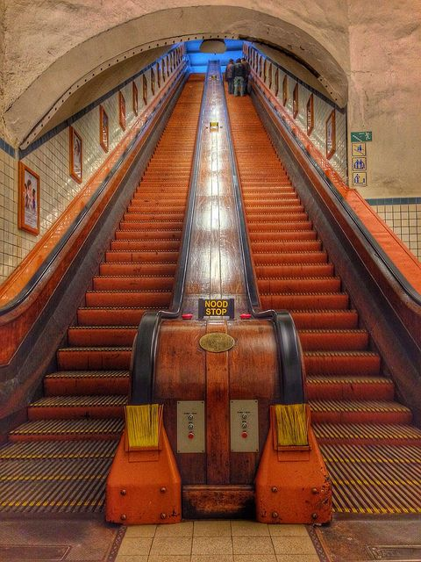
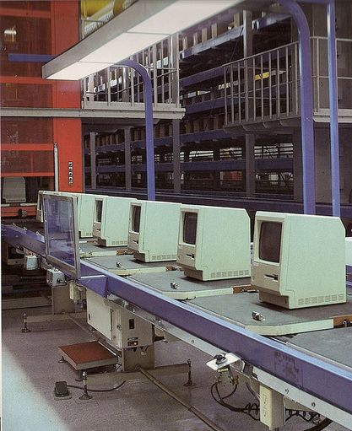
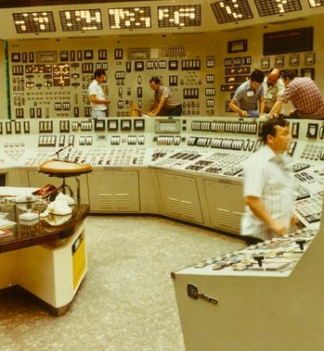
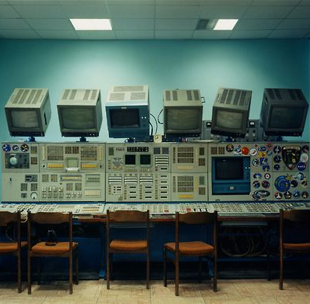
SyndiCorp Building
Beautiful yet soul sucking; a mausoleum of its own history and former product lines.
Stuffy, unwelcoming, inescapable. Not dissimilar to the TVA from Marvel’s “Loki,” filled with technology from the 1960’s – 1980’s.

Slide 6

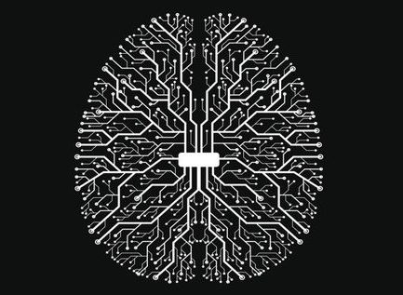
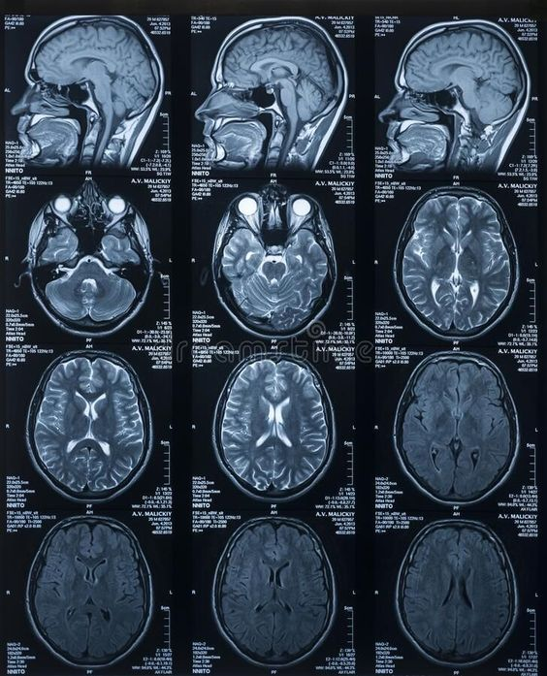
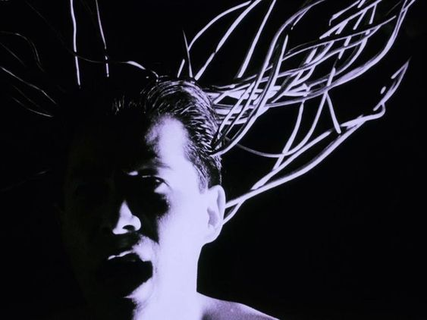
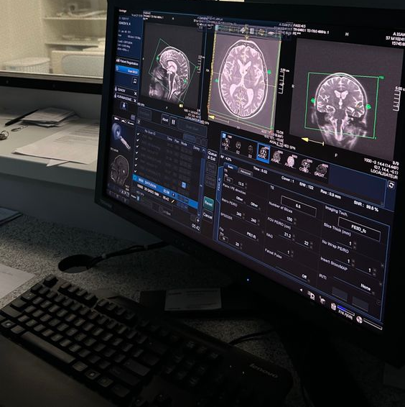
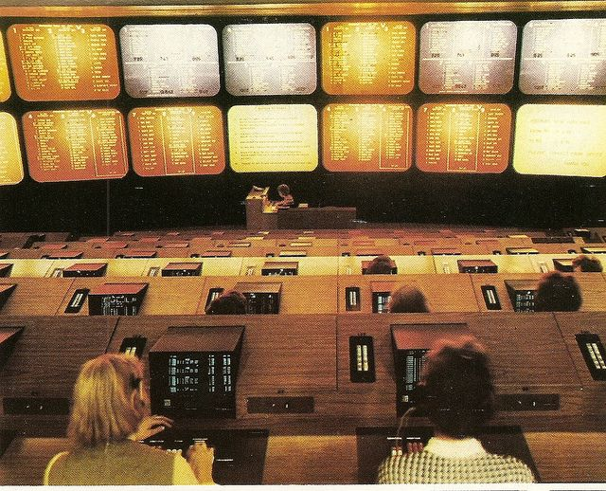
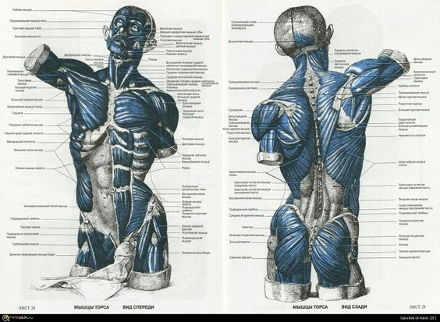
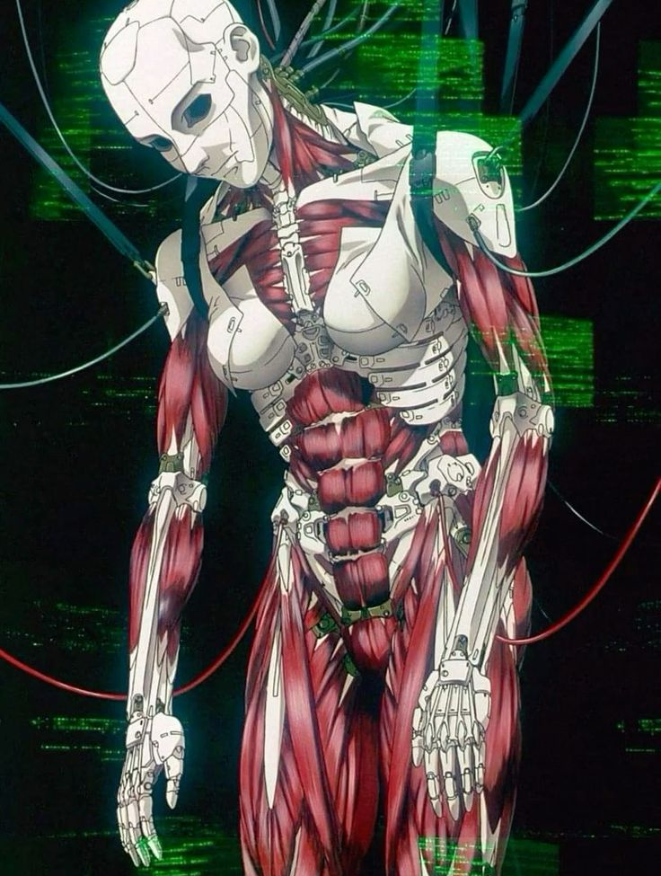
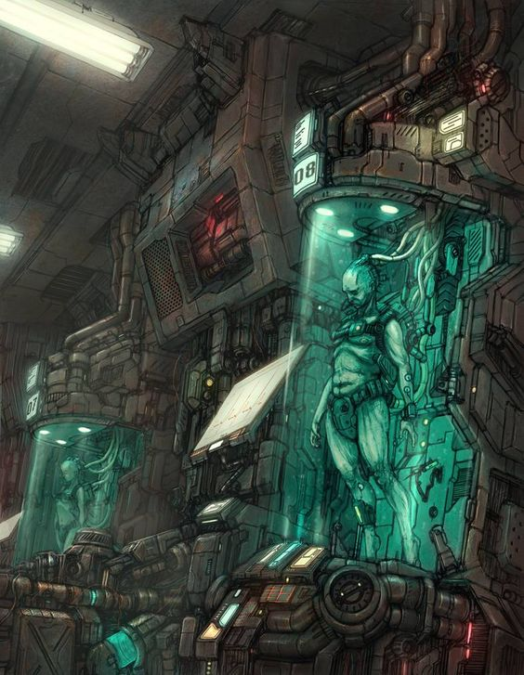
The Experiment
Clones designed for labor. Humans are born; laborers are created. No workman’s comp; just buy a new one and junk the old.
Notes:
Can we turn the brain into a computer? Upload and download consciousness? Memories? Desires? In the process of answering questions about free will and human nature, SyndiCorp aims to make a pretty penny by bringing a new product to market

Slide 7
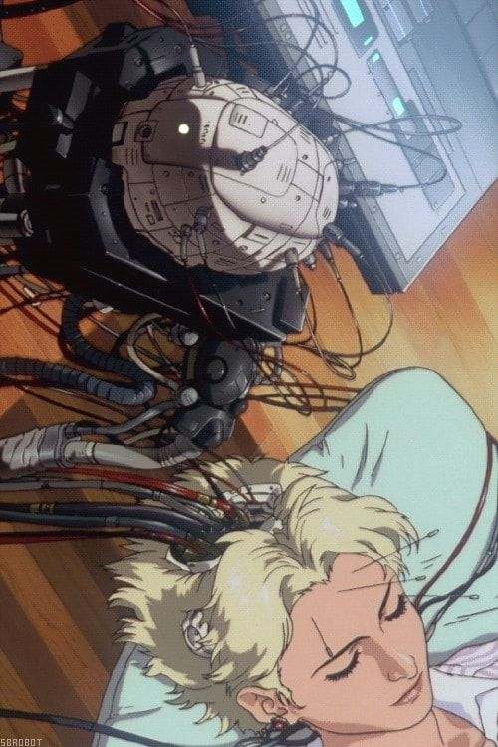

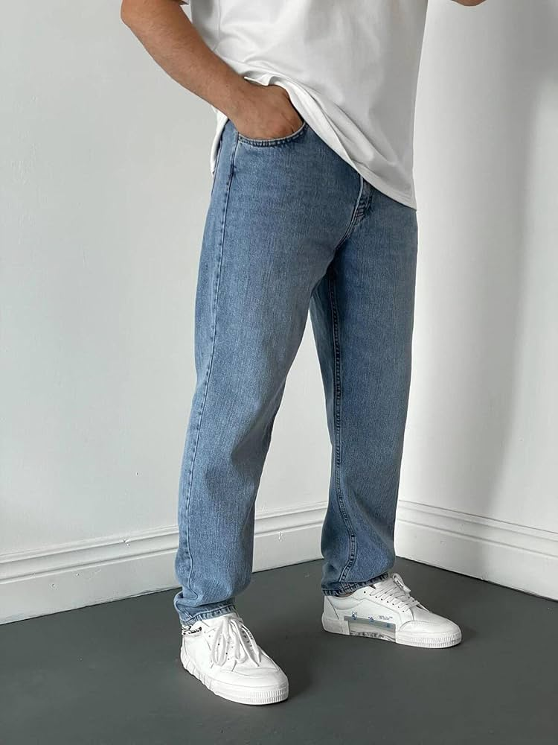
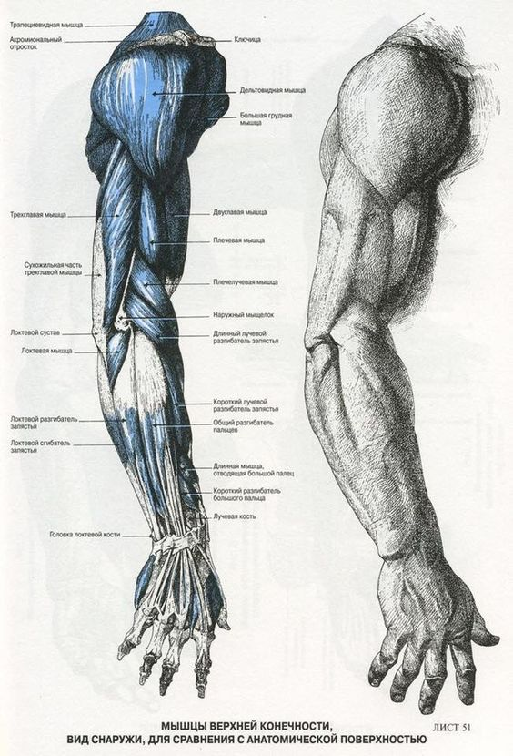
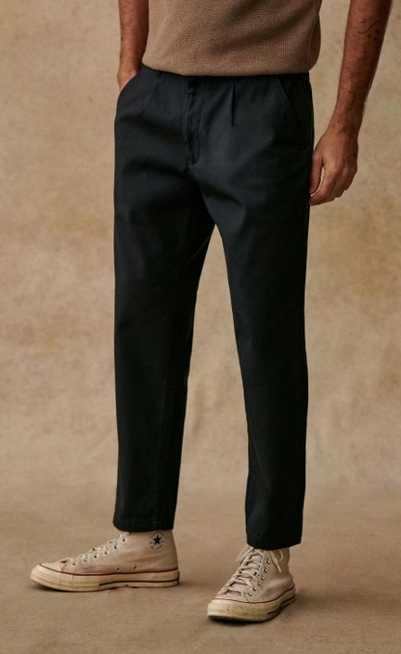
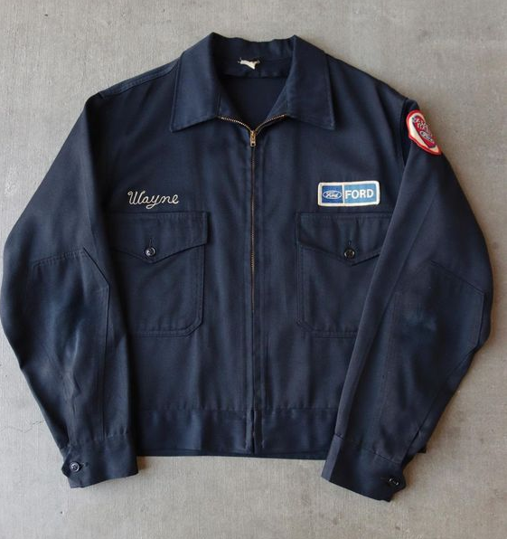
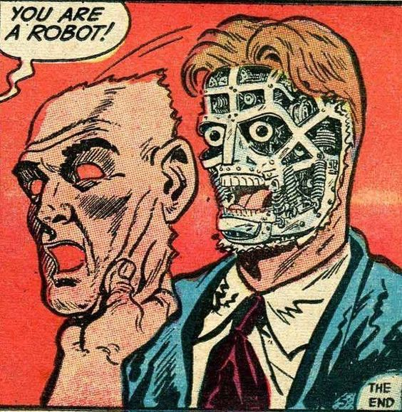
Arnie Rhode
The Future of the Working Class
The product must be tested. Put him in a natural environment and see how well we can control and predict his responses.
Notes:
Arnie is the result of their latest project, an attempt to create programmable cyborgs that can replace all labor. These clones can be subject to horrid conditions, overworked beyond exhaustion, easily replaced whenever they break down, and programmed to enjoy every second of it. They’ve never heard of OSHA or a labor union. Money? They don’t need it. Loved ones? Family? Dreams? Aspirations? They’re not even people, why would they want better for themselves? Arnie-bots don’t need training; you can just upload the relevant information into their BRAIN’s. BRAIN is, of course, short for “Biologically Reprogrammed Artificially Intelligent Neurology.” It’s a bit of a mouthful, hence the acronym. These brain systems are burrowed deep into his brain stem, with access to his memories, language center, motor control, and every other part of his brain. The BRAIN system was developed by experimenting on human subjects, many of whom still work for SyndiCorp as they’re unable to choose otherwise. Several early experiments absconded with the technology.

Slide 8
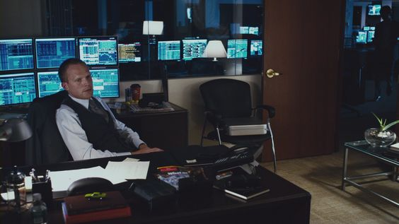

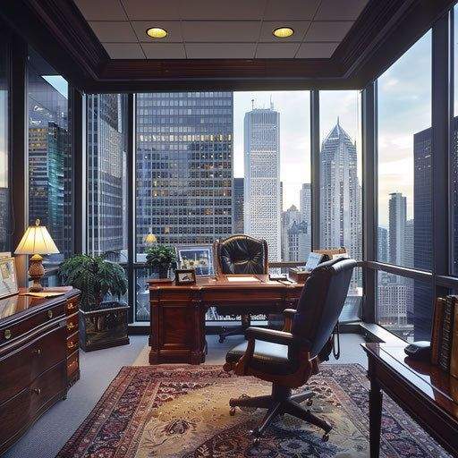

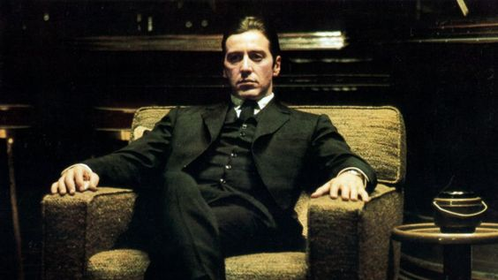
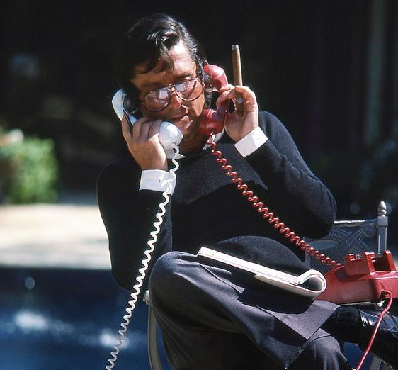
Oliver Hughes
A Father Seeking Redemption
“He’s not my son; he’s a tool for me to fix this family. A blank copy of his DNA, a chance for my son to live his life and to have the dignity of showing his face to the world.”
Notes:
Oliver is the Vice President of Research and Development at SyndiCorp. He is a former automotive engineer who worked with a local engineering firm, but his company was put out of business by SyndiCorp entering the automotive space. He is a widower of Lucinda, an unwell woman who was untreated due to Oliver losing his job and his health insurance.
Unmedicated and without mental health treatment, Lucinda’s mental health spiraled. Desperate for financial support, Oliver and his family went to visit his parents to ask for money. They gave him $10,000 to help cover his bills as he continued looking for work. They drove home in a rainstorm, arguing about the usual stuff (money), and Lucinda insisted that Reno, their toddler, sit in her lap in the passenger seat.
Oliver argued and fought with Lucinda to put little baby Reno back in his car seat, but she refused, insisting she knew best because she was his mother.
An accident ensued; the airbag deployed destroying Reno’s face. Lucinda died instantly.

Slide 9
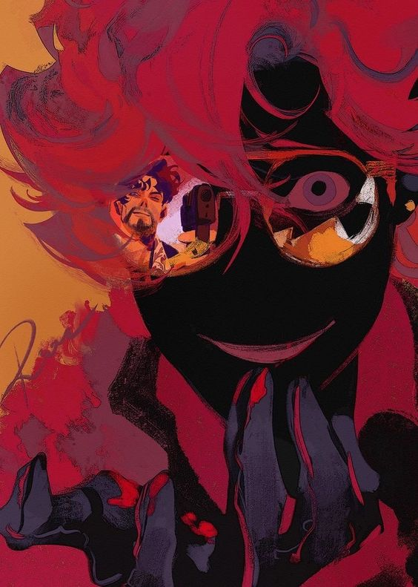




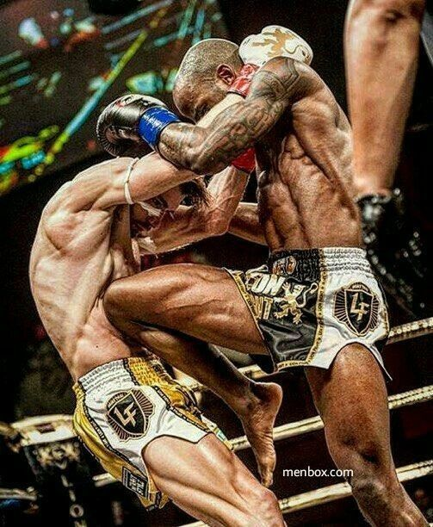

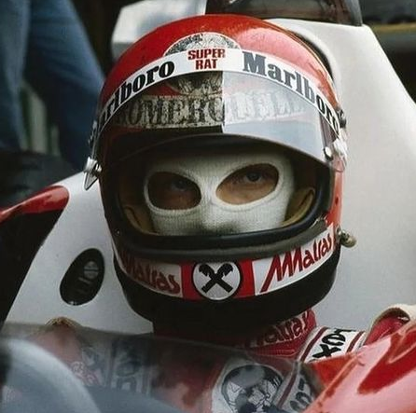

Reno Hughes
“Whose face are we saving?”
“Arnie, make no mistake, your life is a tragedy. Your pain is real. It’s profound. It’s valid. But it’s not special, and it’s certainly not important.”
Notes:
Having lived his entire life with a disfigured face, obscured behind a digitized mask and helmet, Reno is devoid of a true sense of self. After guinea-pigging several early-stage augmentations, Reno was upgraded to a fierce warrior with immense cybernetic upgrades.
Obsessed with beauty, perfection, glory, and self-actualization, Reno has spiraled into a tragic figure. He’s powerful, but with his physiology, he’s too ashamed to face the public. His father might have found a way to give him a renewed chance at life; by using his DNA to create the clones used in the Arnie Experiment, and by using other subjects to develop the BRAIN System, Reno hopes to have a renewed chance at life by transferring his mind into a new blank copy of his body.
Because of his obsession with perfection, he refuses to accept a clone that he cannot defeat in battle. If they don’t have an innate killer instinct and physiology that outmatches his, what’s the point? Why just replace your body when you can upgrade your body?

Slide 10
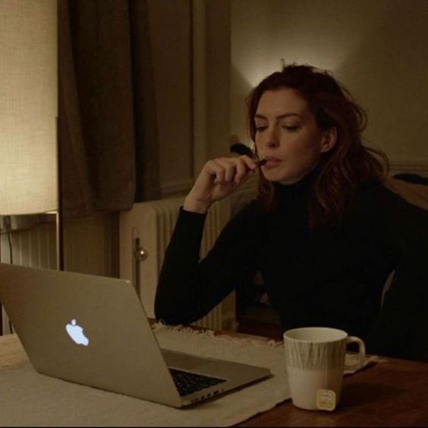


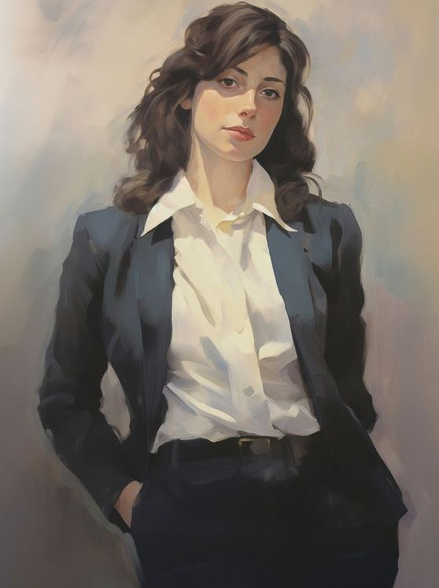
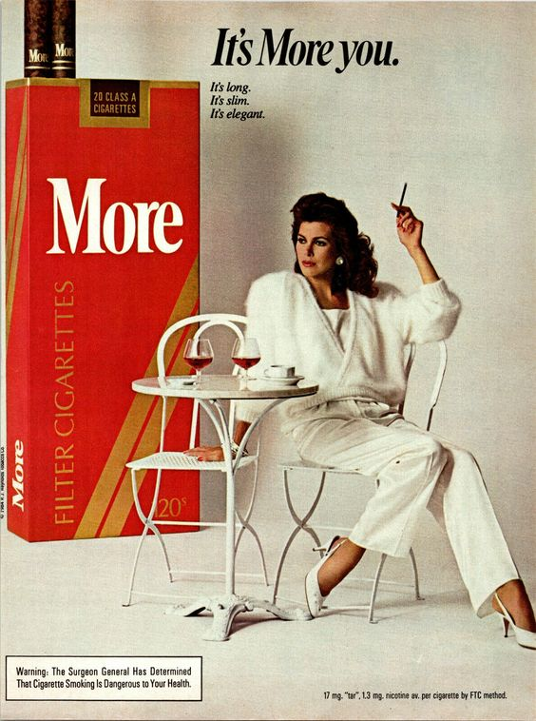
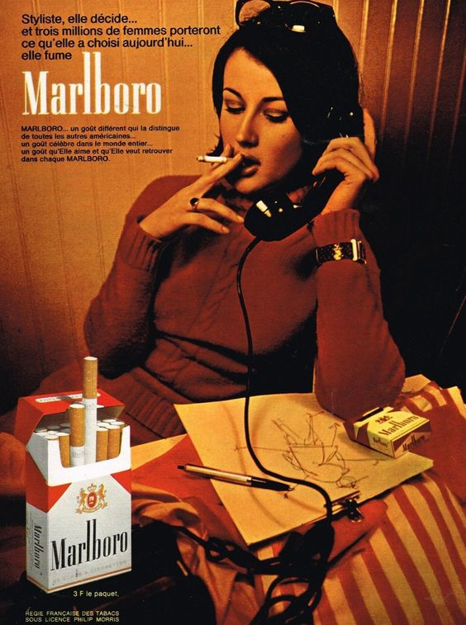
Celine de Los Santos – SyndiCorp’s Least Favorite Project Manager
“Oliver, I need you to just sit in your office, push paper, enjoy the promotion, and stop f***ing with my budget.”
Notes:
As Oliver mourned the loss of his wife, and grieved the tragedy that befell his family and his son, Celine approached him with an opportunity. Sell us the right to your son’s DNA, and we’ll waive his medical bills.

Slide 11




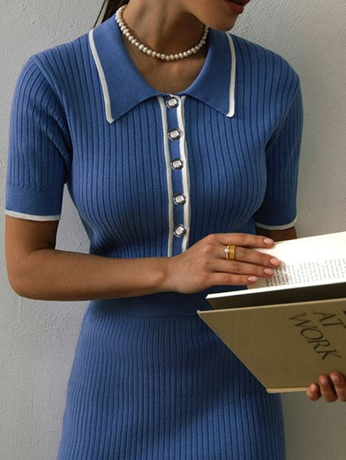
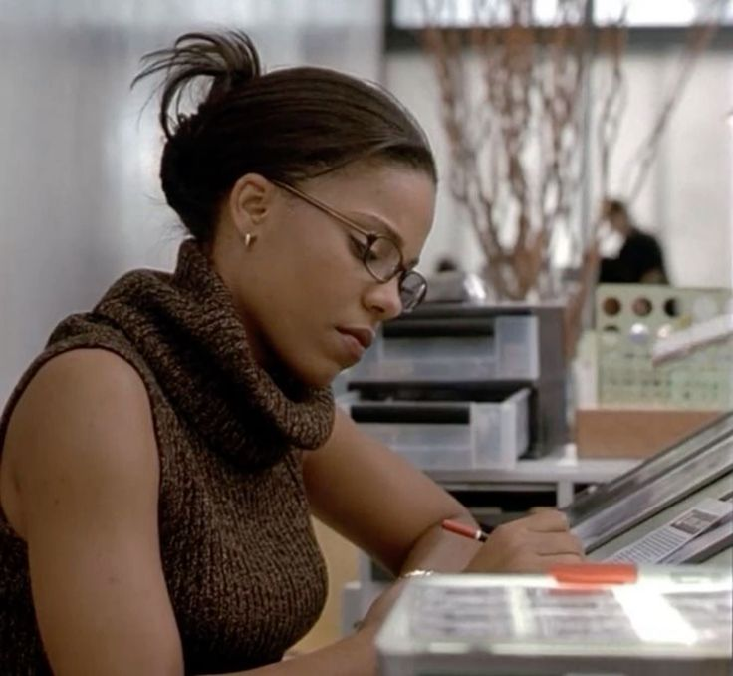

Camille Medina – The Actress
“I can’t stand this company, but I literally can’t do this without them. I’m broke, Arnie. If Oliver deserves that money, so do I. And I refuse to settle for less.”
Notes:
Camille aspires to be one of the so-called “elites,” but she doesn’t see it that way. Vain, selfish, yet devastatingly gorgeous, she’s committed her entire life to acting and the performing arts. Her mother is incredibly unsupportive, of course, but Camille carries on with little regard for her mother’s disapproval. She feels that if she succeeds at SyndiCorp, she can move up in the company and make a difference. Even if she can’t succeed there, she can eventually save enough money to move out to Los Angeles and pursue a career as an actress. She dreams of having a platform that allows her to crush
She’s in constant conflict with her sister, one of SyndiCorp’s previous trials, because of their different approaches to SyndiCorp.

Slide 12
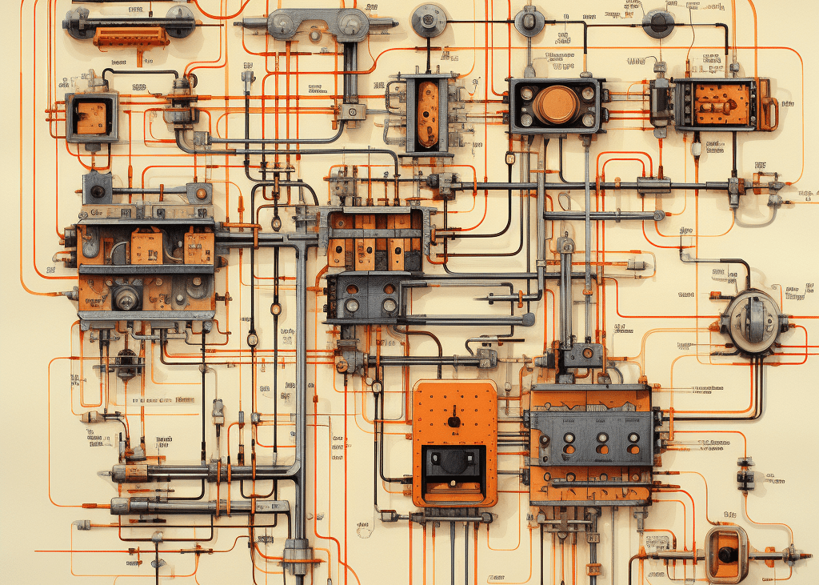
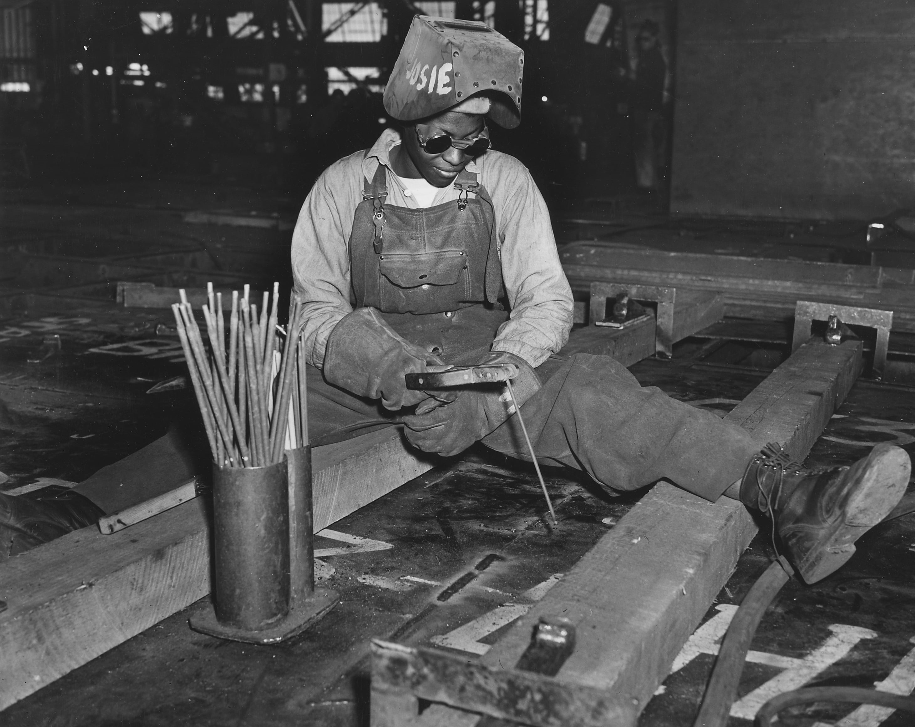
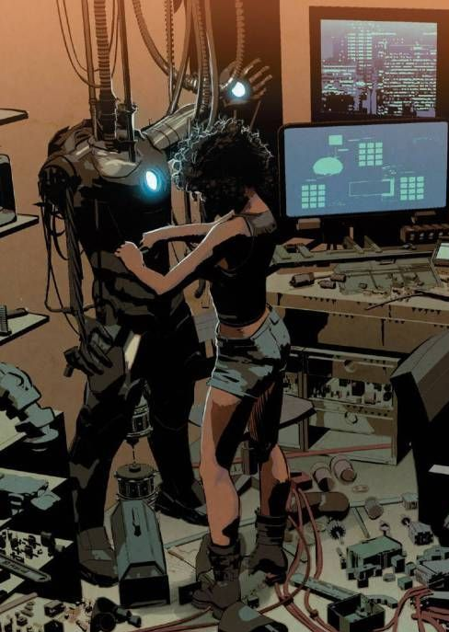
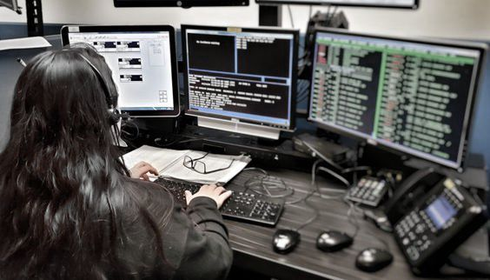
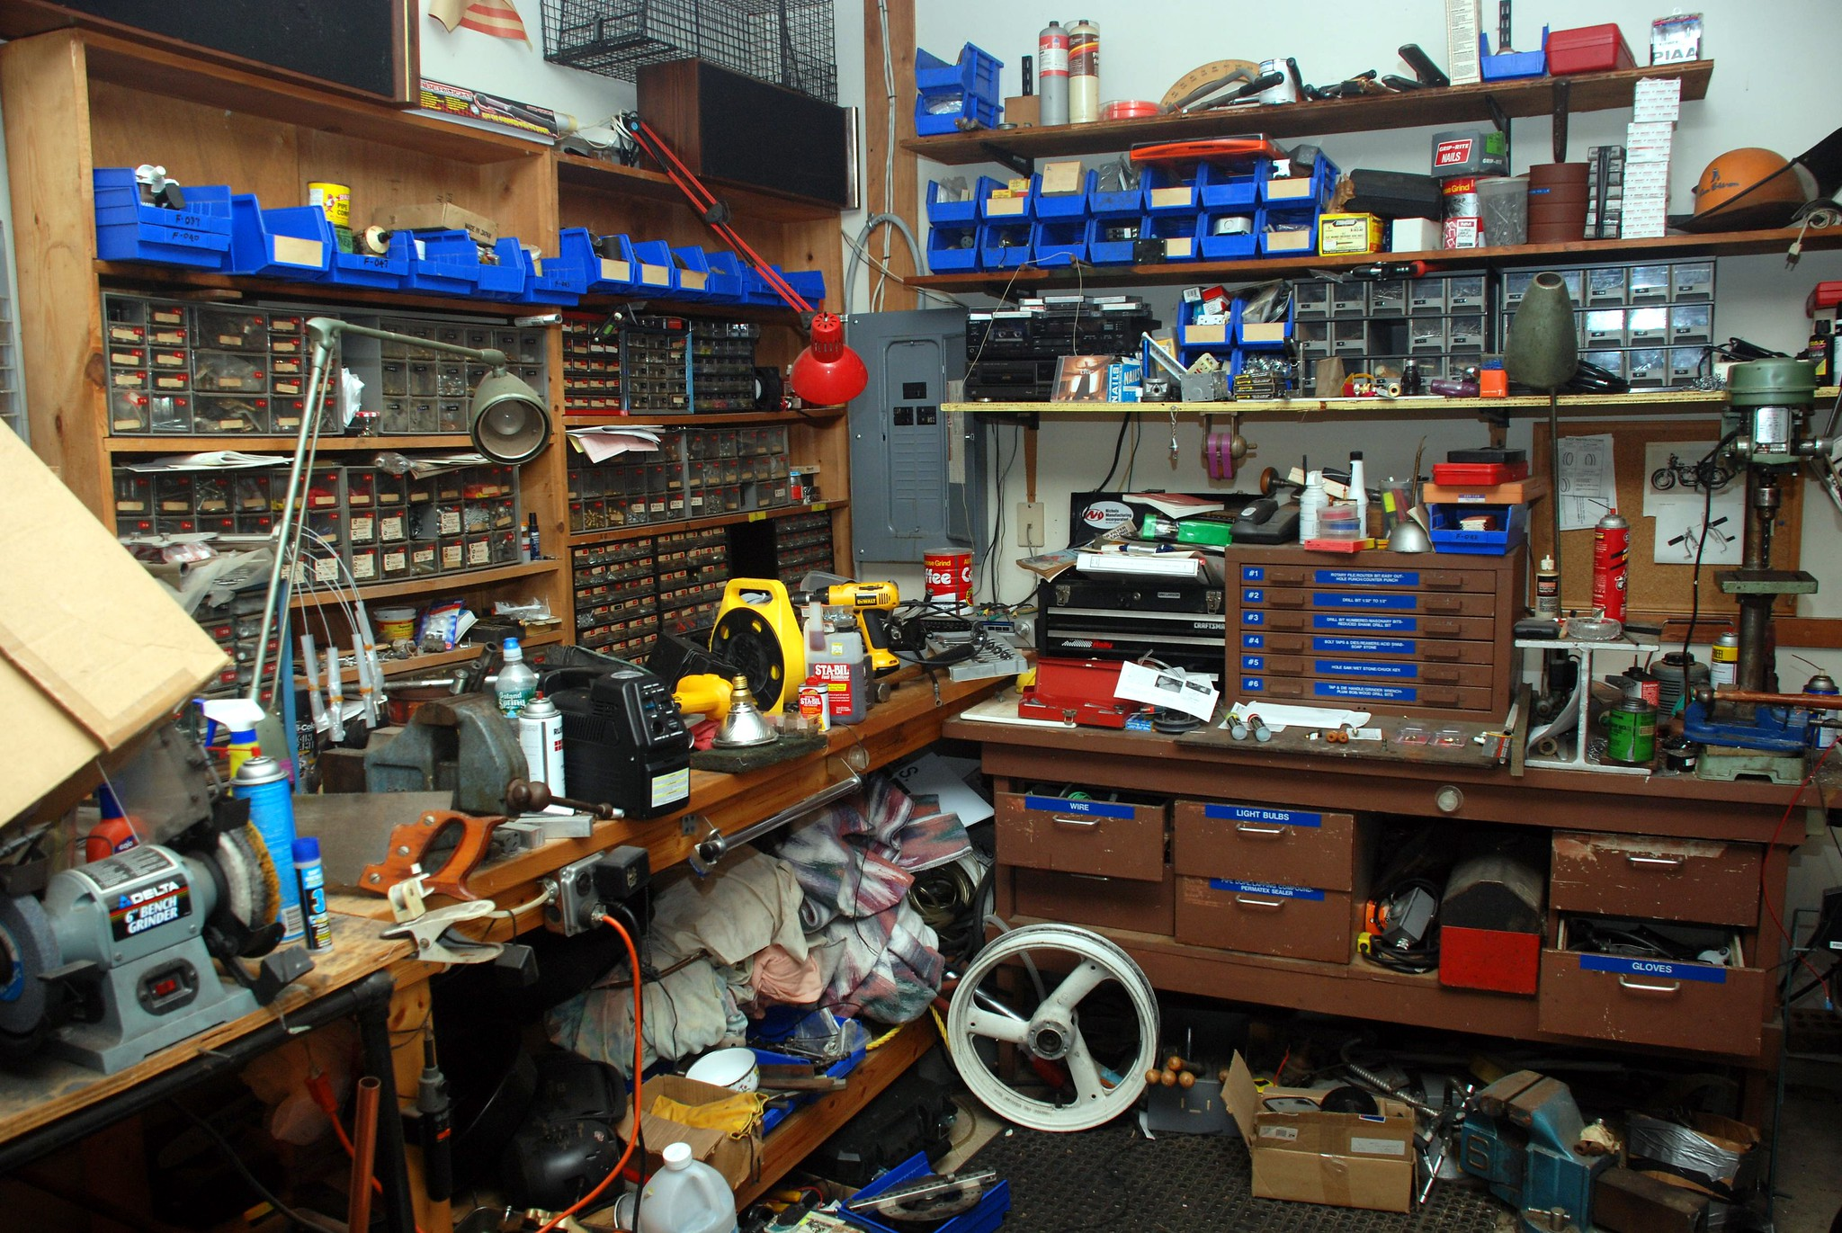
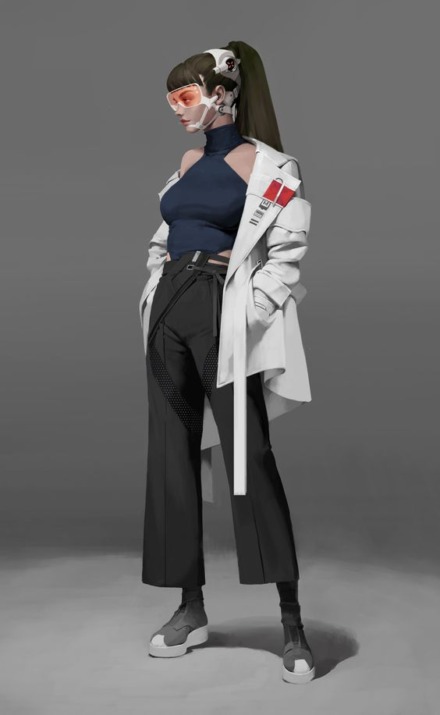

Sylvia “Impact” Medina Unemployable Genius
“Goodness is not enough, and it will never be enough. I’m not nice enough, I’m not sweet enough, I’m an addict. It doesn’t matter how many times I put them back together. Over, and over, and over.”
Notes:
Sylvia is one of the smartest women you’ll ever meet, but living in the shadow of her sister’s beauty drove her to a teenage rebellion that resulted in devastating addiction. With a fierce chip on her shoulder, and

Slide 13






Dominique Medina – UltraVille’s Beloved Blue-Collar Matriarch
“I’ll be damned if I let them start buying our children and selling them for scraps.”
Notes:
She’s the mother of Sylvia and Camille, holds a seat on UltraVille city council, and owns several small businesses. One of these businesses is a local auto shop, where Sylvia is in hiding, working as a mechanic and getting paid under the counter. Ostensibly, publicly, Dominique detests everything that SyndiCorp stands for. Publicly, she rails against them for how difficult they make it to be a small business owner in UltraVille. Even in private, she is often loudly critical of both of her daughters for having accepted money from SyndiCorp.
This makes the end of season 1 that much more devastating, when we reveal that she takes money from SyndiCorp to turn an eye to the unprecedented magnitude of human rights violations that regularly occur as part of SyndiCorp’s regular course of business.

